Slide 1

Inferential Statistics
Introduction to Hypothesis Testing

Slide 2
Deciding if a Sample Represents a Population
Inferential statistics are used to “infer” or make a statement about a population (large group) based on what you find in a sample (a small part of the population).

Slide 3
Parametric and Nonparametric
Parametric statistics require
  The population of dependent scores should be approximately normally distributed
  The scores should be interval or ratio scores
Nonparametric statistics
  Data may be skewed . . . Or
  Scores may be nominal or ordinal scores

Slide 4
Sampling Error
Just by the luck of the draw, the sample we choose may not be representative of the population
The sample may
  Give a fairly accurate representation of the population we’re interested in---or--
  Give a poor representation of the population we’re interested in—or—
  Represent another population altogether

Slide 5
Testing the Sample mean
In order to determine if the sample represents the population, we will subject the sample to a test
The test will vary depending on sample size
  Large samples (≥30) will use a Z test
  Small samples (≤30) will use a t test
Both of these tests (and other inferential tests we will learn in the future) will follow a ten-step process.

Slide 6
Hypotheses
The research hypothesis states that the researcher expects to find something
The null hypothesis states that nothing has happened or that there is no difference
The researcher always tests the null hypothesis and the results are either:
1. Reject the null
2. Retain the null (sometimes worded “fail to reject the null”)

Slide 7
One Tail or Two?
A two-tailed test is used when you do not predict the direction that scores will change.
A one-tailed test is used when you do predict the direction that scores will change.

Slide 8
Alpha Level
How certain do I need to be?
I (the researcher) set the alpha level
Most common in social science is .05
This means I am 95% confident that I can rely on my results
If my test results meet this level, then my results are significant.

Slide 9
Ten Steps to Hypothesis Testing
1. State the null hypothesis (H₀)
2. State the research or alternate hypothesis (H_{a}) (H₁)
3. Identify H₁ as one or two-tailed
4. Specify the alpha level (level of significance)
5. Determine appropriate statistical test
6. Specify the degrees of freedom (not with the z test)

Slide 10
Ten Steps to Hypothesis Testing
7. Identify the Critical Value (z_{crit} or t_{crit})
8. State decision (rejection) rule (use normal distribution curve)
    If the absolute value of the calculated score is greater than critical value, then the null hypothesis is rejected
    If the absolute value of the calculated score is less than the critical value, then there is a failure to reject the null hypothesis
9. Calculate z or t (z_{obt} or t_{obt}) and show it on the normal distribution curve
10. State the meaning of the results in a complete sentence

Slide 11
Steps 1 and 2
The null hypothesis is a statement that “there is no difference” between the two means i.e. the sample mean is no different than the mean of the population
µ₁=µ₂
The research hypothesis is a statement that “there is a difference” between the two means i.e. the sample mean represents a different population.
µ₁≠µ₂

Slide 12
Steps 3 and 4
Identify H₁ as one or two-tailed
  If no direction is predicted, the test is two-tailed and the critical values are located in both tails
  If direction is predicted, the test is one-tailed and critical value is located only in one tail
Specify alpha level
  How confident do I need to be?
  In social sciences 95% confidence level is usually sufficient

Slide 13
Steps 5 and 6
What test should I use (Z or T)?
Determine degrees of freedom (if applicable)
Use appropriate table to determine Critical Value

Slide 14
Steps 7 and 8
Identify Critical Value (Z_{crit} or t_{crit}) on normal distribution curve
State decision (rejection) rule:
  Use the normal distribution curve to mark the “area of rejection”
  If Z_{obt} is greater than Z_{crit}, reject the null hypothesis
  If Z_{obt} is less than Z_{crit}, fail to reject the null hypothesis
  If t_{obt} is greater than t_{crit}, reject the null hypothesis
  If t_{obt} is less than t_{crit}, fail to reject the null hypothesis

Slide 15
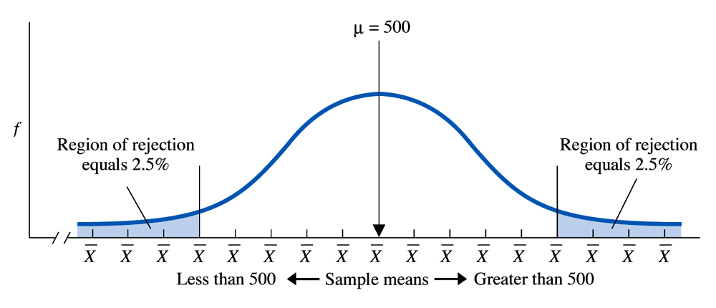
Step 7 and 8

Slide 16
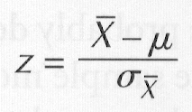
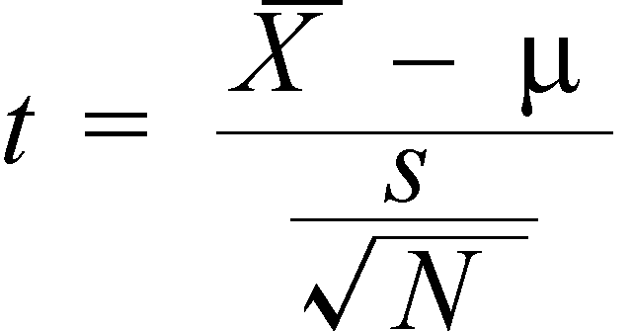
Step 9
Calculate Z_{obt} or t_{obt}

Slide 17
Step 10
State the meaning of the results in a complete sentence.
Example: Reject the null
  There is sufficient evidence at the 5% level to support the claim that the alternative hypothesis represents the population.
Example: Failure to reject the null
  There is insufficient evidence at the 5% level to support the claim of the alternative hypothesis.

Slide 18
Z Test vs. T Test
Perform the Z test when:
  You have a single sample
  The dependent variable is interval/ratio data that is approximately normally distributed
  You know the population mean
  You know the true standard deviation of the population
Perform the T test when:
  You have a single sample
  You do not know the true standard deviation.

Slide 19
Sample Problem
Denise is interested in whether the physical coordination skills among low-income pre-school children are different from those of other children. She knows that the population mean for the Pre-School Coordination Activity Test (PCAT) is 120 with a population standard deviation = 10. She tests 80 pre-schoolers from low-income families and obtains a mean of 122.
  Should Denise do a one-tailed or a two-tailed test? Explain your answer.
  State the appropriate H₀ and H_{a}, given your answer in part a.
  Use α = 0.05. What is the value of z_{crit}?
  What is the value of z_{obt}?
  Use the normal distribution curve and report your findings.
  What should Denise conclude?

Slide 20
Two-tailed test because no direction is predicted
Ho: there is no difference between the physical coordination skills of low –income children and the population of preschoolers.
H1: there is a difference between the physical coordination skills of low –income children and the population of preschoolers.
Zcrit = ±1.96 (two-tailed with α of .05)
Z obt = 1.79
Zobt < 1.96 therefore there is a failure to reject the null hypothesis. There is no different between the physical coordination skills of low-income children and the population of preschoolers.

